Slide 1


List in Python

Slide 2

Why do we need List? (Why)
By keeping a list, you make sure that your tasks are written down all in one place so you don't forget anything important
For example, to make a ‘to-do’ list for daily tasks. You prioritize your tasks while making a list that which tasks are more important and which are less important.
Notes:
Programming sekhny ka maksad hia k ham apni real life problem computer ki madad sy solve ker sakhain.
Ham apni roz mara zindagi main bhot sary decision conditions ki base per lyty hain jesy k
Agr kal barish hoi to ham pick nick per jain gy
Agr aaj school ki chuti hoi to main cartoon daikoun ga
Or Agr kal mjy job mill gi to main aap ko party doun ga.
In conditions ko programming main handel kerny k leay conditional structure use hoty hain.

Slide 3
Why do we need list in Python?
List is used to store multiple data of the same type or different type.
Notes:
Programming sekhny ka maksad hia k ham apni real life problem computer ki madad sy solve ker sakhain.
Ham apni roz mara zindagi main bhot sary decision conditions ki base per lyty hain jesy k
Agr kal barish hoi to ham pick nick per jain gy
Agr aaj school ki chuti hoi to main cartoon daikoun ga
Or Agr kal mjy job mill gi to main aap ko party doun ga.
In conditions ko programming main handel kerny k leay conditional structure use hoty hain.

Slide 4
What is a list in Python?
List is a sequence data type. It is an ordered set of values enclosed in a square bracket [].
It can have any number of items (values, elements) and they may be of different types (integers, floats, strings, etc.)
Values in the list can be modified that’s why list is mutable.
Notes:
Programming sekhny ka maksad hia k ham apni real life problem computer ki madad sy solve ker sakhain.
Ham apni roz mara zindagi main bhot sary decision conditions ki base per lyty hain jesy k
Agr kal barish hoi to ham pick nick per jain gy
Agr aaj school ki chuti hoi to main cartoon daikoun ga
Or Agr kal mjy job mill gi to main aap ko party doun ga.
In conditions ko programming main handel kerny k leay conditional structure use hoty hain.

Slide 5
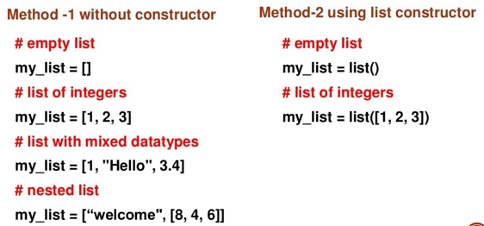
Creating a list in Python?
List is creating by placing all the items (elements) inside a square bracket [], separated by commas.
Notes:
Programming sekhny ka maksad hia k ham apni real life problem computer ki madad sy solve ker sakhain.
Ham apni roz mara zindagi main bhot sary decision conditions ki base per lyty hain jesy k
Agr kal barish hoi to ham pick nick per jain gy
Agr aaj school ki chuti hoi to main cartoon daikoun ga
Or Agr kal mjy job mill gi to main aap ko party doun ga.
In conditions ko programming main handel kerny k leay conditional structure use hoty hain.

Slide 6
Creating a list in Python?
List is creating by placing all the items (elements) inside a square bracket [], separated by commas.
Notes:
Programming sekhny ka maksad hia k ham apni real life problem computer ki madad sy solve ker sakhain.
Ham apni roz mara zindagi main bhot sary decision conditions ki base per lyty hain jesy k
Agr kal barish hoi to ham pick nick per jain gy
Agr aaj school ki chuti hoi to main cartoon daikoun ga
Or Agr kal mjy job mill gi to main aap ko party doun ga.
In conditions ko programming main handel kerny k leay conditional structure use hoty hain.

Slide 7
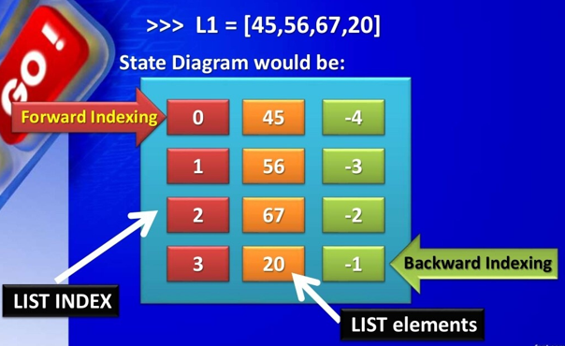
State Diagram of a list?
Notes:
Programming sekhny ka maksad hia k ham apni real life problem computer ki madad sy solve ker sakhain.
Ham apni roz mara zindagi main bhot sary decision conditions ki base per lyty hain jesy k
Agr kal barish hoi to ham pick nick per jain gy
Agr aaj school ki chuti hoi to main cartoon daikoun ga
Or Agr kal mjy job mill gi to main aap ko party doun ga.
In conditions ko programming main handel kerny k leay conditional structure use hoty hain.

Slide 8
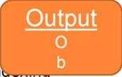
Accessing item from a list?
Use the Index operator [] to access an item in a list.
Index starts from zero so a list having 5 elements will have index from 0(zero) to 4.
Example:
List= [‘p’,’r’,’o’,’b’,’p’]
Print(list[2]) #Positive indexing
Print(list[-2]) #Negative indexing
Output
O
b
Notes:
Programming sekhny ka maksad hia k ham apni real life problem computer ki madad sy solve ker sakhain.
Ham apni roz mara zindagi main bhot sary decision conditions ki base per lyty hain jesy k
Agr kal barish hoi to ham pick nick per jain gy
Agr aaj school ki chuti hoi to main cartoon daikoun ga
Or Agr kal mjy job mill gi to main aap ko party doun ga.
In conditions ko programming main handel kerny k leay conditional structure use hoty hain.

Slide 9
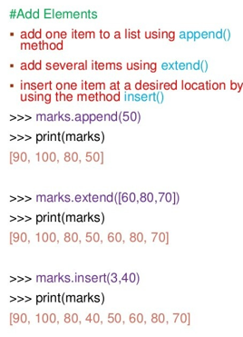
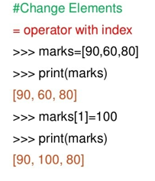
How to cahnge or add list element?
Notes:
Programming sekhny ka maksad hia k ham apni real life problem computer ki madad sy solve ker sakhain.
Ham apni roz mara zindagi main bhot sary decision conditions ki base per lyty hain jesy k
Agr kal barish hoi to ham pick nick per jain gy
Agr aaj school ki chuti hoi to main cartoon daikoun ga
Or Agr kal mjy job mill gi to main aap ko party doun ga.
In conditions ko programming main handel kerny k leay conditional structure use hoty hain.

Slide 10
List Operators?
Slicing [::] (i.e) list[start:stop:step]
Concatenation =+
Repetition =*
Membership = in
Identity = is
Notes:
Programming sekhny ka maksad hia k ham apni real life problem computer ki madad sy solve ker sakhain.
Ham apni roz mara zindagi main bhot sary decision conditions ki base per lyty hain jesy k
Agr kal barish hoi to ham pick nick per jain gy
Agr aaj school ki chuti hoi to main cartoon daikoun ga
Or Agr kal mjy job mill gi to main aap ko party doun ga.
In conditions ko programming main handel kerny k leay conditional structure use hoty hain.

Slide 11
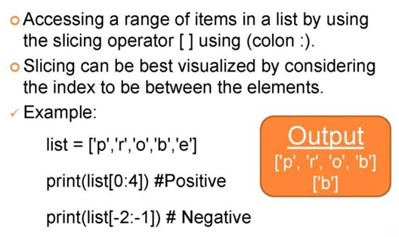
List operator slicing?
Output
[‘p’, ‘r’, ‘o’, ‘b’]
[‘b’]
Notes:
Programming sekhny ka maksad hia k ham apni real life problem computer ki madad sy solve ker sakhain.
Ham apni roz mara zindagi main bhot sary decision conditions ki base per lyty hain jesy k
Agr kal barish hoi to ham pick nick per jain gy
Agr aaj school ki chuti hoi to main cartoon daikoun ga
Or Agr kal mjy job mill gi to main aap ko party doun ga.
In conditions ko programming main handel kerny k leay conditional structure use hoty hain.

Slide 12
List oprator concatenation?
We can use + operator to combine two lists. This is called concatenation.
Example:
A=[1,2,3]
B=[4,5,6] C=A+B
print(C)
Output: [1, 2, 3, 4, 5, 6]
Notes:
Programming sekhny ka maksad hia k ham apni real life problem computer ki madad sy solve ker sakhain.
Ham apni roz mara zindagi main bhot sary decision conditions ki base per lyty hain jesy k
Agr kal barish hoi to ham pick nick per jain gy
Agr aaj school ki chuti hoi to main cartoon daikoun ga
Or Agr kal mjy job mill gi to main aap ko party doun ga.
In conditions ko programming main handel kerny k leay conditional structure use hoty hain.

Slide 13
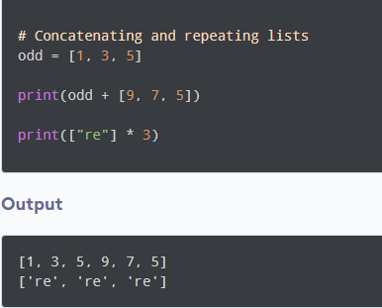
List oprator repetition?
The * operator repeats a list for the given number.
Notes:
Programming sekhny ka maksad hia k ham apni real life problem computer ki madad sy solve ker sakhain.
Ham apni roz mara zindagi main bhot sary decision conditions ki base per lyty hain jesy k
Agr kal barish hoi to ham pick nick per jain gy
Agr aaj school ki chuti hoi to main cartoon daikoun ga
Or Agr kal mjy job mill gi to main aap ko party doun ga.
In conditions ko programming main handel kerny k leay conditional structure use hoty hain.

Slide 14
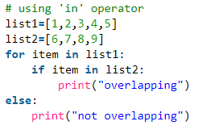
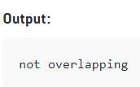
List oprator membership?
The ‘in’ operator is used to check if a value exists in a sequence or not. Evaluates to true if it finds a variable in the specified sequence and false otherwise.
Notes:
Programming sekhny ka maksad hia k ham apni real life problem computer ki madad sy solve ker sakhain.
Ham apni roz mara zindagi main bhot sary decision conditions ki base per lyty hain jesy k
Agr kal barish hoi to ham pick nick per jain gy
Agr aaj school ki chuti hoi to main cartoon daikoun ga
Or Agr kal mjy job mill gi to main aap ko party doun ga.
In conditions ko programming main handel kerny k leay conditional structure use hoty hain.

Slide 15
List oprator identity?
The ‘in’ operator is used to check if a value exists in a sequence or not. Evaluates to true if it finds a variable in the specified sequence and false otherwise.
Notes:
Programming sekhny ka maksad hia k ham apni real life problem computer ki madad sy solve ker sakhain.
Ham apni roz mara zindagi main bhot sary decision conditions ki base per lyty hain jesy k
Agr kal barish hoi to ham pick nick per jain gy
Agr aaj school ki chuti hoi to main cartoon daikoun ga
Or Agr kal mjy job mill gi to main aap ko party doun ga.
In conditions ko programming main handel kerny k leay conditional structure use hoty hain.

Slide 16
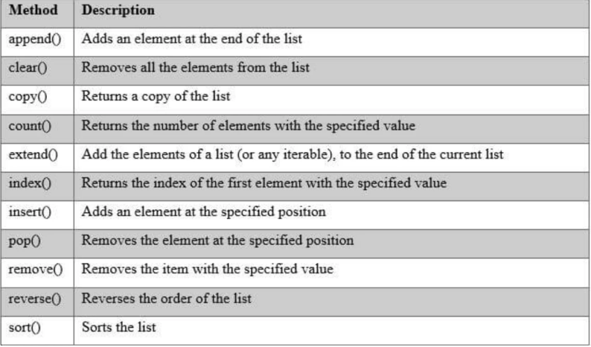
Python List Methods?
Slicing [::] (i.e) list[start:stop:step]
Concatenation =+
Repetition =*
Membership = in
Identity = is
Notes:
Programming sekhny ka maksad hia k ham apni real life problem computer ki madad sy solve ker sakhain.
Ham apni roz mara zindagi main bhot sary decision conditions ki base per lyty hain jesy k
Agr kal barish hoi to ham pick nick per jain gy
Agr aaj school ki chuti hoi to main cartoon daikoun ga
Or Agr kal mjy job mill gi to main aap ko party doun ga.
In conditions ko programming main handel kerny k leay conditional structure use hoty hain.

Slide 17
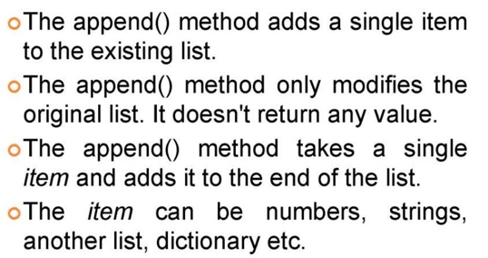
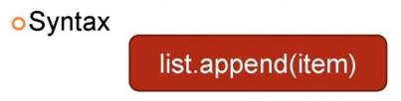
Python List Append Method?
Slic
Notes:
Programming sekhny ka maksad hia k ham apni real life problem computer ki madad sy solve ker sakhain.
Ham apni roz mara zindagi main bhot sary decision conditions ki base per lyty hain jesy k
Agr kal barish hoi to ham pick nick per jain gy
Agr aaj school ki chuti hoi to main cartoon daikoun ga
Or Agr kal mjy job mill gi to main aap ko party doun ga.
In conditions ko programming main handel kerny k leay conditional structure use hoty hain.

Slide 18
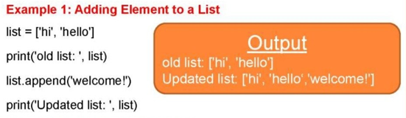
Python List Append Method?
Slic
Output
old list: [‘hi’, ‘hello’]
Updated list: [‘hi’, ‘hello’, ‘welcome’]
Notes:
Programming sekhny ka maksad hia k ham apni real life problem computer ki madad sy solve ker sakhain.
Ham apni roz mara zindagi main bhot sary decision conditions ki base per lyty hain jesy k
Agr kal barish hoi to ham pick nick per jain gy
Agr aaj school ki chuti hoi to main cartoon daikoun ga
Or Agr kal mjy job mill gi to main aap ko party doun ga.
In conditions ko programming main handel kerny k leay conditional structure use hoty hain.

Slide 19
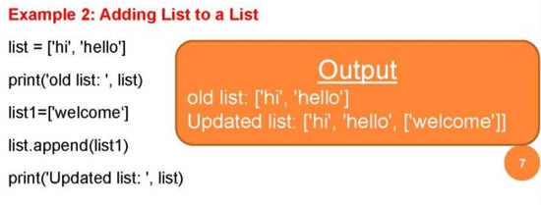
Python List Append Method?
Slic
Output
old list: [‘hi’, ‘hello’]
Updated list: [‘hi’, ‘hello’, [‘welcome’]]
Notes:
Programming sekhny ka maksad hia k ham apni real life problem computer ki madad sy solve ker sakhain.
Ham apni roz mara zindagi main bhot sary decision conditions ki base per lyty hain jesy k
Agr kal barish hoi to ham pick nick per jain gy
Agr aaj school ki chuti hoi to main cartoon daikoun ga
Or Agr kal mjy job mill gi to main aap ko party doun ga.
In conditions ko programming main handel kerny k leay conditional structure use hoty hain.

Slide 20
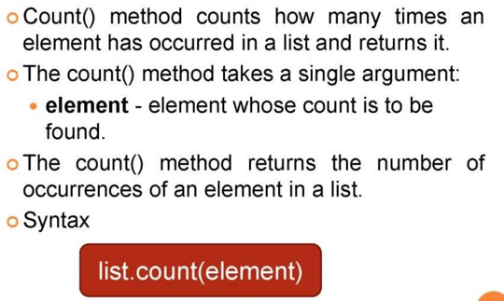
Python List Count Method?
Slic
Notes:
Programming sekhny ka maksad hia k ham apni real life problem computer ki madad sy solve ker sakhain.
Ham apni roz mara zindagi main bhot sary decision conditions ki base per lyty hain jesy k
Agr kal barish hoi to ham pick nick per jain gy
Agr aaj school ki chuti hoi to main cartoon daikoun ga
Or Agr kal mjy job mill gi to main aap ko party doun ga.
In conditions ko programming main handel kerny k leay conditional structure use hoty hain.

Slide 21
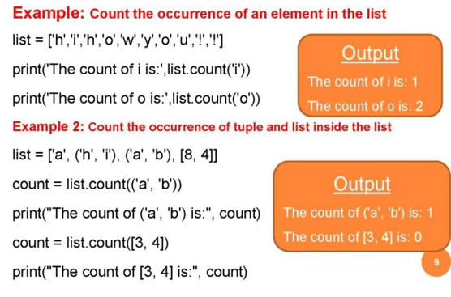
Python List Count Method?
Slic
Output
The count of i is: 1
The count of o is: 2
Output
The count of (‘a’, ’b’) is: 1
The count of [3,4] is: 0
Notes:
Programming sekhny ka maksad hia k ham apni real life problem computer ki madad sy solve ker sakhain.
Ham apni roz mara zindagi main bhot sary decision conditions ki base per lyty hain jesy k
Agr kal barish hoi to ham pick nick per jain gy
Agr aaj school ki chuti hoi to main cartoon daikoun ga
Or Agr kal mjy job mill gi to main aap ko party doun ga.
In conditions ko programming main handel kerny k leay conditional structure use hoty hain.

Slide 22
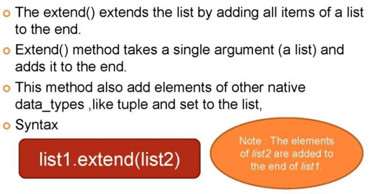
Python List Extend Method?
Slic
Note: The elements of lsit2 are added to the end of list1
Notes:
Programming sekhny ka maksad hia k ham apni real life problem computer ki madad sy solve ker sakhain.
Ham apni roz mara zindagi main bhot sary decision conditions ki base per lyty hain jesy k
Agr kal barish hoi to ham pick nick per jain gy
Agr aaj school ki chuti hoi to main cartoon daikoun ga
Or Agr kal mjy job mill gi to main aap ko party doun ga.
In conditions ko programming main handel kerny k leay conditional structure use hoty hain.

Slide 23
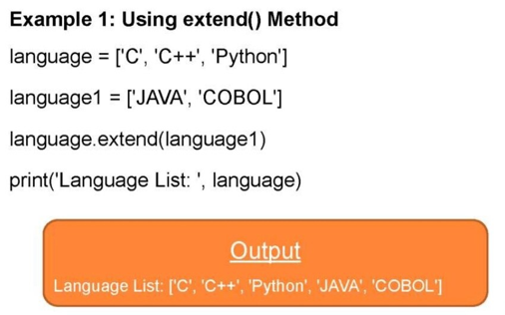
Python List Extend Method?
Slic
Output
Language List: [‘C’, ‘C++’, ‘Python’, ‘JAVA’, ‘COBOL’]
Notes:
Programming sekhny ka maksad hia k ham apni real life problem computer ki madad sy solve ker sakhain.
Ham apni roz mara zindagi main bhot sary decision conditions ki base per lyty hain jesy k
Agr kal barish hoi to ham pick nick per jain gy
Agr aaj school ki chuti hoi to main cartoon daikoun ga
Or Agr kal mjy job mill gi to main aap ko party doun ga.
In conditions ko programming main handel kerny k leay conditional structure use hoty hain.

Slide 24
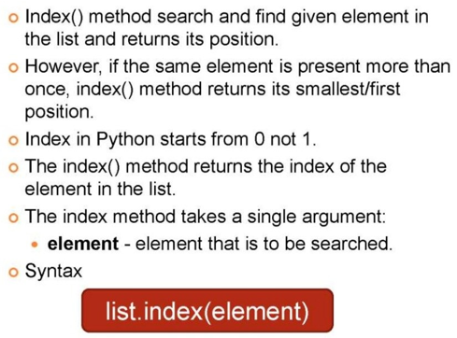
Python List Index Method?
Slic
Notes:
Programming sekhny ka maksad hia k ham apni real life problem computer ki madad sy solve ker sakhain.
Ham apni roz mara zindagi main bhot sary decision conditions ki base per lyty hain jesy k
Agr kal barish hoi to ham pick nick per jain gy
Agr aaj school ki chuti hoi to main cartoon daikoun ga
Or Agr kal mjy job mill gi to main aap ko party doun ga.
In conditions ko programming main handel kerny k leay conditional structure use hoty hain.

Slide 25
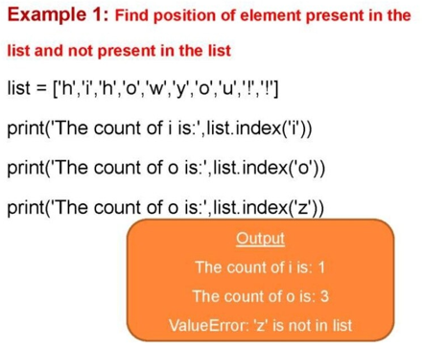
Python List Index Method?
Slic
Output
The count of i is: 1
The count of o is: 3
VlueEror: ‘z’ is not in list
Notes:
Programming sekhny ka maksad hia k ham apni real life problem computer ki madad sy solve ker sakhain.
Ham apni roz mara zindagi main bhot sary decision conditions ki base per lyty hain jesy k
Agr kal barish hoi to ham pick nick per jain gy
Agr aaj school ki chuti hoi to main cartoon daikoun ga
Or Agr kal mjy job mill gi to main aap ko party doun ga.
In conditions ko programming main handel kerny k leay conditional structure use hoty hain.

Slide 26
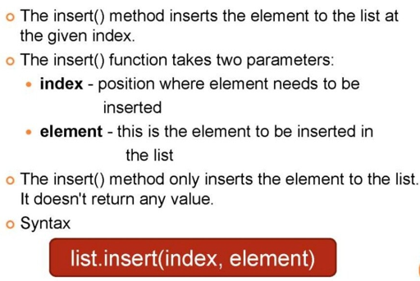
Python List Insert Method?
Slic
Notes:
Programming sekhny ka maksad hia k ham apni real life problem computer ki madad sy solve ker sakhain.
Ham apni roz mara zindagi main bhot sary decision conditions ki base per lyty hain jesy k
Agr kal barish hoi to ham pick nick per jain gy
Agr aaj school ki chuti hoi to main cartoon daikoun ga
Or Agr kal mjy job mill gi to main aap ko party doun ga.
In conditions ko programming main handel kerny k leay conditional structure use hoty hain.

Slide 27
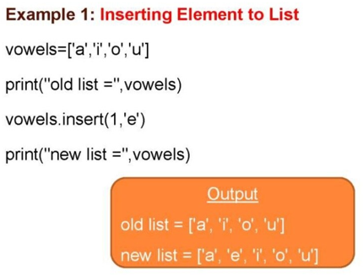
Python List Insert Method?
Slic
Output
old list: [‘a’,’i’, ‘o’, ‘u’]
new list: [‘a’,’e’,’i’, ‘o’, ‘u’]
Notes:
Programming sekhny ka maksad hia k ham apni real life problem computer ki madad sy solve ker sakhain.
Ham apni roz mara zindagi main bhot sary decision conditions ki base per lyty hain jesy k
Agr kal barish hoi to ham pick nick per jain gy
Agr aaj school ki chuti hoi to main cartoon daikoun ga
Or Agr kal mjy job mill gi to main aap ko party doun ga.
In conditions ko programming main handel kerny k leay conditional structure use hoty hain.

Slide 28
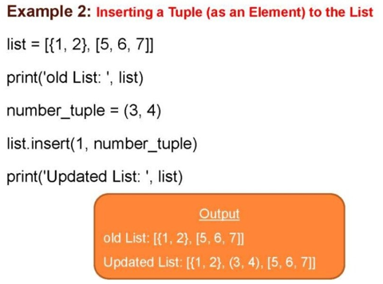
Python List Insert Method?
Slic
Output
old list: [{1,2},[5,6,7]]
Updated list: [{1,2},{3,4},[5,6,7]]

Slide 29
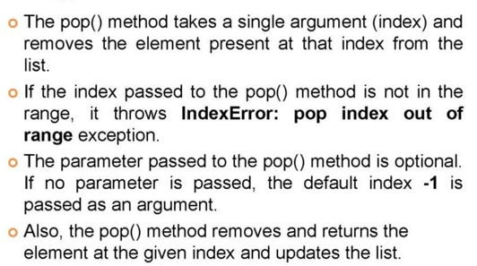
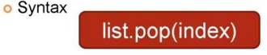
Python List Pop Method?
Slic

Slide 30
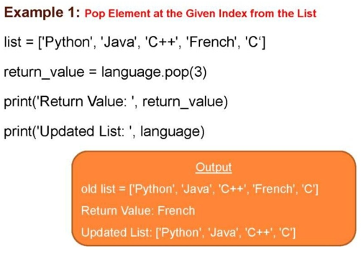
Python List Pop Method?
Slic
Output
old list: [‘Python’, ‘Java’, ‘C++’, ‘French’, ‘C’]
Return Value: French
Updated list: [‘Python’, ‘Java’, ‘C++’, ‘C’]

Slide 31
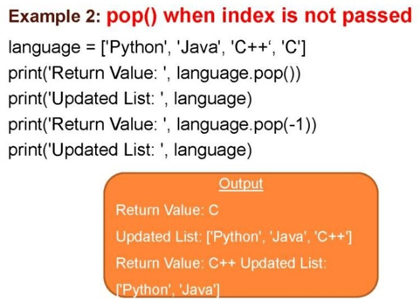
Python List Pop Method?
Slic
Output
Return Value: C
Updated list: [‘Python’, ‘Java’, ‘C++’]
Return Value: C++
Updated List: [‘Python’, ‘Java’]

Slide 32
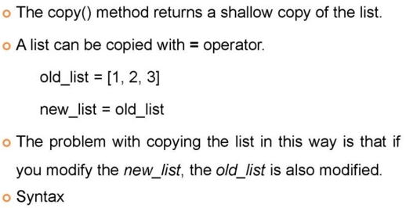

Python List Copy Method?
Slic

Slide 33
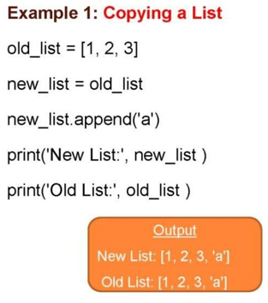
Python List Copy Method?
Slic
Output
New List: [1,2,3, ‘a’]
Old List: [1,2,3,’a’]

Slide 34
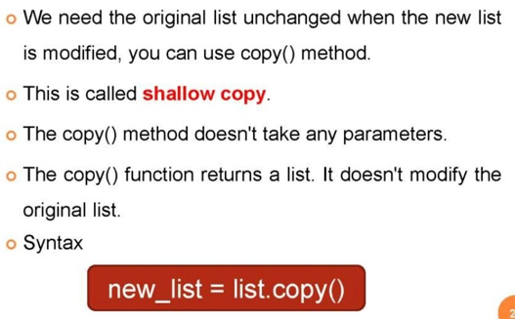
Python List Shallow Copy Method?
Slic

Slide 35
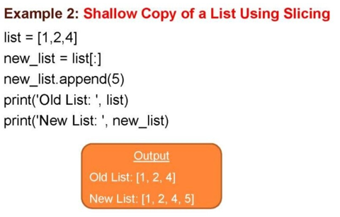
Python List Shallow Copy Method?
Slic
Output
New List: [1,2,4]
Old List: [1,2,4,5]

Slide 36
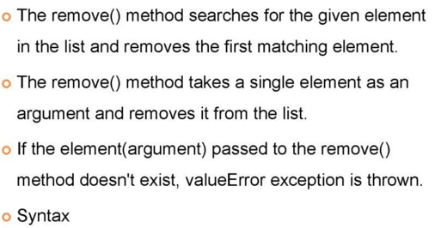
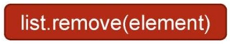
Python List Remove Method?
Slic

Slide 37
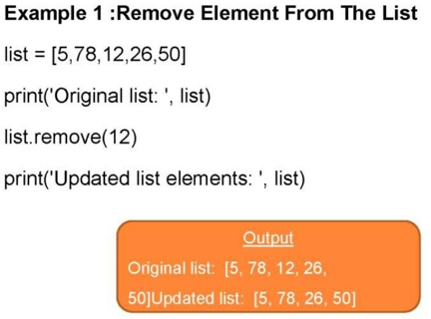
Python List Remove Method?
Slic
Output
Original list: [5,78,12,26,50]
Updated List: [5,78,26,50]

Slide 38
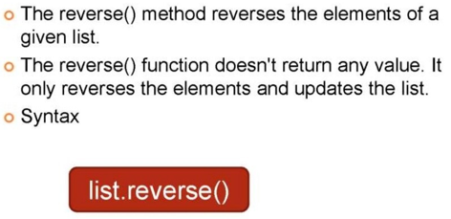
Python List Revrse Method?
Slic

Slide 39
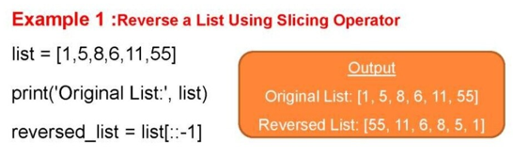
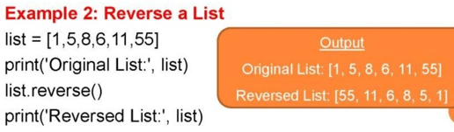
Python List Revrse Method?
Slic
Output
Original list: [1,5,8,6,11,55]
Reversed List: [55,11,6,8,5,1]
Output
Original list: [1,5,8,6,11,55]
Reversed List: [55,11,6,8,5,1]

Slide 40
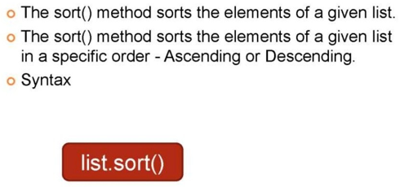
Python List Sort Method?
Slic

Slide 41
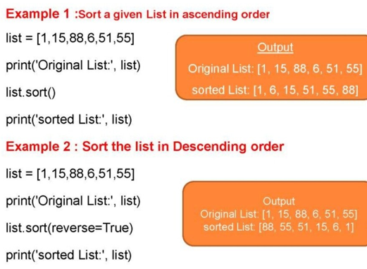
Python List Sort Method?
Slic
Output
Original list: [1,15,88,6,51,55]
sorted List: [1,6,15,51,55,88]
Output
Original list: [1,15,88,6,51,55]
sorted List: [88,55,51,15,6,1]

Slide 42
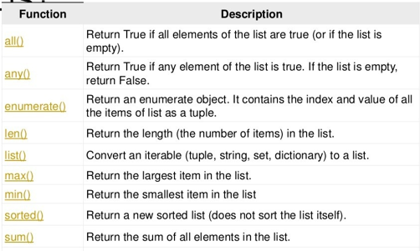
Built-in Functions with list?
Slic

Slide 43
Tuples in Python

Slide 44
Why do we need tuple in Python?
A tuple is also used to store multiple data of the same type or different type.
Notes:
Programming sekhny ka maksad hia k ham apni real life problem computer ki madad sy solve ker sakhain.
Ham apni roz mara zindagi main bhot sary decision conditions ki base per lyty hain jesy k
Agr kal barish hoi to ham pick nick per jain gy
Agr aaj school ki chuti hoi to main cartoon daikoun ga
Or Agr kal mjy job mill gi to main aap ko party doun ga.
In conditions ko programming main handel kerny k leay conditional structure use hoty hain.

Slide 45
What is a tuple in Python?
A tuple is a collection which is ordered and unchangeable.
Tuple items are ordered, unchangeable, and allow duplicate values
Notes:
Programming sekhny ka maksad hia k ham apni real life problem computer ki madad sy solve ker sakhain.
Ham apni roz mara zindagi main bhot sary decision conditions ki base per lyty hain jesy k
Agr kal barish hoi to ham pick nick per jain gy
Agr aaj school ki chuti hoi to main cartoon daikoun ga
Or Agr kal mjy job mill gi to main aap ko party doun ga.
In conditions ko programming main handel kerny k leay conditional structure use hoty hain.

Slide 46
How tuple is different from list?
Tuples are immutable objects the lists are mutable. This means that tuples cannot be changed while the lists can be modified.
Tuples use parentheses (), whereas lists use square brackets [].
Notes:
Programming sekhny ka maksad hia k ham apni real life problem computer ki madad sy solve ker sakhain.
Ham apni roz mara zindagi main bhot sary decision conditions ki base per lyty hain jesy k
Agr kal barish hoi to ham pick nick per jain gy
Agr aaj school ki chuti hoi to main cartoon daikoun ga
Or Agr kal mjy job mill gi to main aap ko party doun ga.
In conditions ko programming main handel kerny k leay conditional structure use hoty hain.

Slide 47
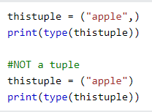
Creating a tuple in Python?
Tuple is creating by placing all the items (elements) inside a round bracket (), separated by commas.
To create a tuple with only one item, you have to add a comma after the item, otherwise Python will not recognize it as a tuple.
Output: <class ‘tuple’>
Output: <class ‘string’>

Slide 48
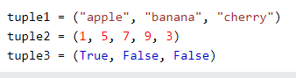
Creating a tuple in Python?
To create a tuple with multiple item, you add comma after every element except the last one.

Slide 49
Creating a tuple in Python?
Tuple can also be created using a tuple constructor ‘tuple()’.
Output: (‘apple’, ‘banana’, ‘cherry’)

Slide 50
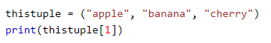
Accessing item from a tuple?
You can access tuple items by referring to the index number, inside square brackets same as we access element from a list.
Example:
tuple1=("apple", "banana", "cherry", "orange", "kiwi") print(tuple1[1:3])
Output: ('cherry', 'orange', 'kiwi')
Output: banana
Notes:
Programming sekhny ka maksad hia k ham apni real life problem computer ki madad sy solve ker sakhain.
Ham apni roz mara zindagi main bhot sary decision conditions ki base per lyty hain jesy k
Agr kal barish hoi to ham pick nick per jain gy
Agr aaj school ki chuti hoi to main cartoon daikoun ga
Or Agr kal mjy job mill gi to main aap ko party doun ga.
In conditions ko programming main handel kerny k leay conditional structure use hoty hain.

Slide 51
How to update a tuple?
Tuple is unchangeable but you can convert tuple into list, change a list, and then convert list back into a tuple.
Example:
x = ("apple", "banana", "cherry") y = list(x) y[1] = "kiwi" x = tuple(y) print(x)
Output: ("apple", “kiwi", "cherry")
Notes:
Programming sekhny ka maksad hia k ham apni real life problem computer ki madad sy solve ker sakhain.
Ham apni roz mara zindagi main bhot sary decision conditions ki base per lyty hain jesy k
Agr kal barish hoi to ham pick nick per jain gy
Agr aaj school ki chuti hoi to main cartoon daikoun ga
Or Agr kal mjy job mill gi to main aap ko party doun ga.
In conditions ko programming main handel kerny k leay conditional structure use hoty hain.

Slide 52
How to add an item in a tuple?
1. Since tuples are immutable, they do not have a build-in append() method, but you can convert it into a list, add your item(s), and convert it back into a tuple.
Example:
thistuple = ("apple", "banana", "cherry") y = list(thistuple) y.append("orange") thistuple = tuple(y)
Output: ("apple", “banana", "cherry“,”orange”)
Notes:
Programming sekhny ka maksad hia k ham apni real life problem computer ki madad sy solve ker sakhain.
Ham apni roz mara zindagi main bhot sary decision conditions ki base per lyty hain jesy k
Agr kal barish hoi to ham pick nick per jain gy
Agr aaj school ki chuti hoi to main cartoon daikoun ga
Or Agr kal mjy job mill gi to main aap ko party doun ga.
In conditions ko programming main handel kerny k leay conditional structure use hoty hain.

Slide 53
How to add an item in a tuple?
2. You are allowed to add tuples to tuples, so if you want to add one item, (or many), create a new tuple with the item(s), and add it to the existing tuple:
Example:
thistuple = ("apple", "banana", "cherry") y = ("orange",) thistuple += y print(thistuple)
Output: ("apple", “banana", "cherry“,”orange”)
Notes:
Programming sekhny ka maksad hia k ham apni real life problem computer ki madad sy solve ker sakhain.
Ham apni roz mara zindagi main bhot sary decision conditions ki base per lyty hain jesy k
Agr kal barish hoi to ham pick nick per jain gy
Agr aaj school ki chuti hoi to main cartoon daikoun ga
Or Agr kal mjy job mill gi to main aap ko party doun ga.
In conditions ko programming main handel kerny k leay conditional structure use hoty hain.

Slide 54
How to remove an item in a tuple?
2. In the same way you add an element in a tuple, you can remove an element from a tuple.
Example:
thistuple = ("apple", "banana", "cherry") y = list(thistuple) y.remove("apple") thistuple = tuple(y)
Output: (“banana", "cherry“)
Notes:
Programming sekhny ka maksad hia k ham apni real life problem computer ki madad sy solve ker sakhain.
Ham apni roz mara zindagi main bhot sary decision conditions ki base per lyty hain jesy k
Agr kal barish hoi to ham pick nick per jain gy
Agr aaj school ki chuti hoi to main cartoon daikoun ga
Or Agr kal mjy job mill gi to main aap ko party doun ga.
In conditions ko programming main handel kerny k leay conditional structure use hoty hain.

Slide 55
How to unpack a tuple?
When we create a tuple, we normally assign values to it. This is called "packing" a tuple. But, in Python, we are also allowed to extract the values back into variables. This is called "unpacking":
Example Unpacking:
fruits = ("apple", "banana", "cherry") (green, yellow, red) = fruits print(green) print(yellow) print(red)
Output: Apple
Output: banana
Output: cherry
Notes:
Programming sekhny ka maksad hia k ham apni real life problem computer ki madad sy solve ker sakhain.
Ham apni roz mara zindagi main bhot sary decision conditions ki base per lyty hain jesy k
Agr kal barish hoi to ham pick nick per jain gy
Agr aaj school ki chuti hoi to main cartoon daikoun ga
Or Agr kal mjy job mill gi to main aap ko party doun ga.
In conditions ko programming main handel kerny k leay conditional structure use hoty hain.

Slide 56
How to unpack a tuple?
Using Asterisk (*): If the number of variables is less than the number of values, you can add an * to the variable name and the values will be assigned to the variable as a list
Example Unpacking:
fruits = ("apple", "banana", "cherry“, “strawberry”) (green, yellow, red) = fruits print(green) print(yellow) print(red)
Output: Apple
Output: banana
Output: [cherry, strawberry]
Notes:
Programming sekhny ka maksad hia k ham apni real life problem computer ki madad sy solve ker sakhain.
Ham apni roz mara zindagi main bhot sary decision conditions ki base per lyty hain jesy k
Agr kal barish hoi to ham pick nick per jain gy
Agr aaj school ki chuti hoi to main cartoon daikoun ga
Or Agr kal mjy job mill gi to main aap ko party doun ga.
In conditions ko programming main handel kerny k leay conditional structure use hoty hain.

Slide 57
How to unpack a tuple?
Using Asterisk (*): If the number of variables is less than the number of values, you can add an * to the variable name and the values will be assigned to the variable as a list
Example Unpacking:
fruits = ("apple", "banana", "cherry“, “strawberry”) (green, yellow, red) = fruits print(green) print(yellow) print(red)
Output: Apple
Output: banana
Output: [cherry, strawberry]
Notes:
Programming sekhny ka maksad hia k ham apni real life problem computer ki madad sy solve ker sakhain.
Ham apni roz mara zindagi main bhot sary decision conditions ki base per lyty hain jesy k
Agr kal barish hoi to ham pick nick per jain gy
Agr aaj school ki chuti hoi to main cartoon daikoun ga
Or Agr kal mjy job mill gi to main aap ko party doun ga.
In conditions ko programming main handel kerny k leay conditional structure use hoty hain.

Slide 58
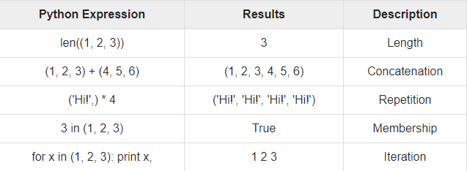
Basic tuple operations?
Tuples respond to the + and * operators much like strings; they mean concatenation and repetition here too, except that the result is a new tuple, not a string.
Notes:
Programming sekhny ka maksad hia k ham apni real life problem computer ki madad sy solve ker sakhain.
Ham apni roz mara zindagi main bhot sary decision conditions ki base per lyty hain jesy k
Agr kal barish hoi to ham pick nick per jain gy
Agr aaj school ki chuti hoi to main cartoon daikoun ga
Or Agr kal mjy job mill gi to main aap ko party doun ga.
In conditions ko programming main handel kerny k leay conditional structure use hoty hain.

Slide 59
Tuple methods?
Python has built-in methods that you can use on tuples.
count(): Returns the number of times a specified value occurs in a tuple.
index(): Searches the tuple for a specified value and returns the position of where it was found.
len(): Gives the total length of a tuple.
tuple(seq): Convert list into tuple.
cmp(tuple1,tuple2): Compares elements of both tuples.
Notes:
Programming sekhny ka maksad hia k ham apni real life problem computer ki madad sy solve ker sakhain.
Ham apni roz mara zindagi main bhot sary decision conditions ki base per lyty hain jesy k
Agr kal barish hoi to ham pick nick per jain gy
Agr aaj school ki chuti hoi to main cartoon daikoun ga
Or Agr kal mjy job mill gi to main aap ko party doun ga.
In conditions ko programming main handel kerny k leay conditional structure use hoty hain.

Slide 60

Learning Objective
In this lecture, we learnt what is a list, why we need list, how to create and write a list in Python and which operations we can perform on list.
Notes:
After this lecture, you shall be able to Explain why we need variables and what is their relation to the memory.

Slide 61

Conclusion
To store multiple data in programming, list and tuple is used.
With the help of list method operator and tuple methods we can perform many operations on list and tuple respectively.
Built-In functins can also be used on list
and tuple.
Notes:
Programming main decision making achieve kerny k leay conditional structure use hoty hain, comparision operator jisy ham double equal operator bhe bolyt hian 2 values ko compare kerny k leay use hota hia.
Is k elawa if command main likhe jany wali condition ko ham Boolean expression bhe khety hain.

Slide 62

Self Assessment
Solve the Following Programs
Write a program to sum all the elements in a list.
Write a program to get a largest element in a list.
Write a program to check a list is empty or not?
Write a program to copy a lsit.

Slide 63
Self Assessment
Solve Following Programs
Write a Program that takes two lists and returns true if they have at least one common element.
Write a program to generate and print a list of first and last 5 elements where the values are square of numbers between 1 and 30 (both included).

Slide 64
Self Assessment
Solve Following Programs
Write a program to print the numbers of a specified list after removing even numbers from it.
Write a program to print a specified list after remvoing the 0th, 4th and 5th elements.
Sample list=[‘yellow”,”Pink”,”Red”,”Green”,”Blue”,”Purple”]
Output =[‘”Pink”,”Red”,”Green”]

Slide 65
Self Assessment
Solve the Following Programs
Write a program to print the first element of a tuple.
Write a program to get a last element in a tuple using negative indexing.
Write a program to use a range of indexes to print the third, fourth, and fifth item in the tuple

Slide 66
Self Assessment
Solve Following Programs
Write a program to print the numbers of a specified tuple after removing even numbers from it.
Write a program to print a specified tuple after remvoing the 0th, 4th and 5th elements.
Sample list=(”yellow”,”Pink”,”Red”,”Green”,”Blue”,”Purple”)
Output =(”Pink”,”Red”,”Green”)

